Slide 1

The online Survey System Micro Service
Covid-19 Return to work survey

Slide 2

About
Online Survey System is a micro service which conducts Covid 19 return to work survey and stores all the participants responses with all questions in the H2 database. It also displays the participants’ answers and the overall results in different charts. So, it is easy to get an idea about people’s interests.
Covid 19 Return to work survey helps people to express their interests to return to work and assessed based on different questions on different areas. It also helps the organizations to take important decisions after seeing the chart results.

Slide 3
Functionality Diagram
Repository
Web browser
Controller
Service Layer
Model
Request
Response
JPA Entity
H2 Database
View
Thyme leaf Template

Slide 4
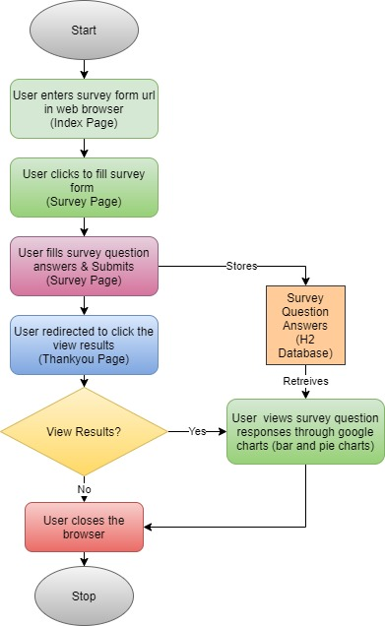
Flow Chart

Slide 5

Q & A

Slide 6

Thank you

